Slide 1

Customer Churn in Airline Industry
By Adit Kaneria,
Aditi Nagardeolekar,
Ian Ustanik,
Lalit Mohan,
Shriya Samant

Slide 2
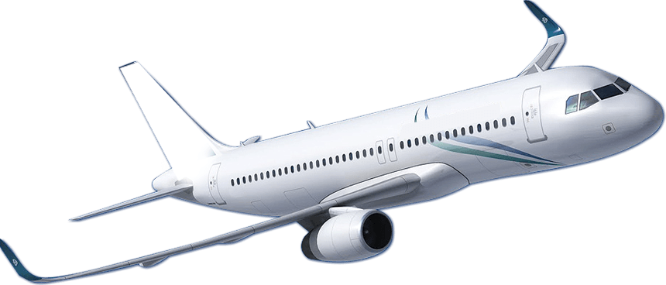
Table of Contents
Overview
Approach
Business Questions
Descriptive Statistics
Modeling
Results
Actionable Insight

Slide 3

Overview
SouthEast Airlines is Facing a Problem with Customer Churn.
A data set containing Survey data is used to calculate NPS.
Net Promoter Score(NPS) asks customer to response on a scale of 1-10.
Scores:
Below 7 : Detractors
Between 7-8 : Passive
Above 8 : Promoter

Slide 4
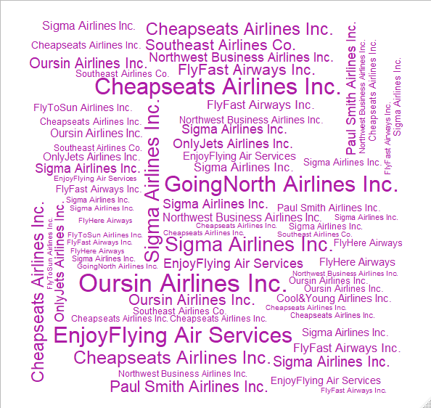
Approach
We have used visualization to explain our models.
We have used sentiment analysis to analyze the sentiment the of the customer.
The three Models we used for our analyses:
Association Rule Mining
Linear Regression
Deep Learning (Sequential Modeling)
Partner Airlines

Slide 5

Business Questions
How does SouthEast Airlines reduce Customer Churn?
Who is the average customer?
What is the correlation between NPS and customer experiences and their attributes?
Who are Detractors?
What can be done to limit the number of customers who become detractors?
Who are Promoters?
What can be done to invest more in experiences and products that turn customers into promoters?

Slide 6

Descriptive Statistics
All 10,282 records with 28 attributes in the dataset were evaluated.
The average customer:
46 years old
Has been flying with SouthEast since 2007
Flies nearly 20 times per year
Spends almost $95 on average per airport visit
Is a frequent flyer
Most significant attributes led to a decrease in NPS as they increased (Age, Price Sensitivity, Flights Per Year, Delay Times).

Slide 7
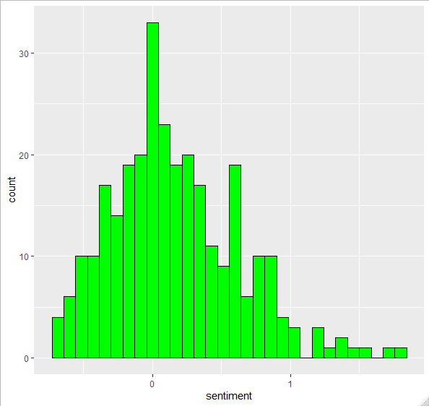
Sentiment Analysis of Customer Reviews

Slide 8
Sentiment Analysis of Customer Reviews
Number of customer who have a positive sentiment towards the airline - 172
Number of customers who have a negative sentiment towards the airline - 115
Likelihood to recommend metric is closely related to reviews customers have given.
Last 294 entries were used for sentiment analysis

Slide 9
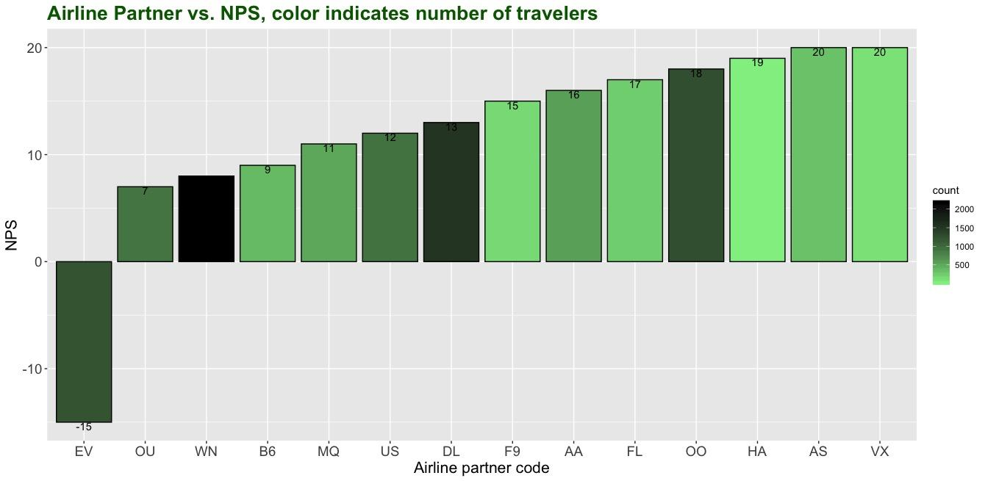
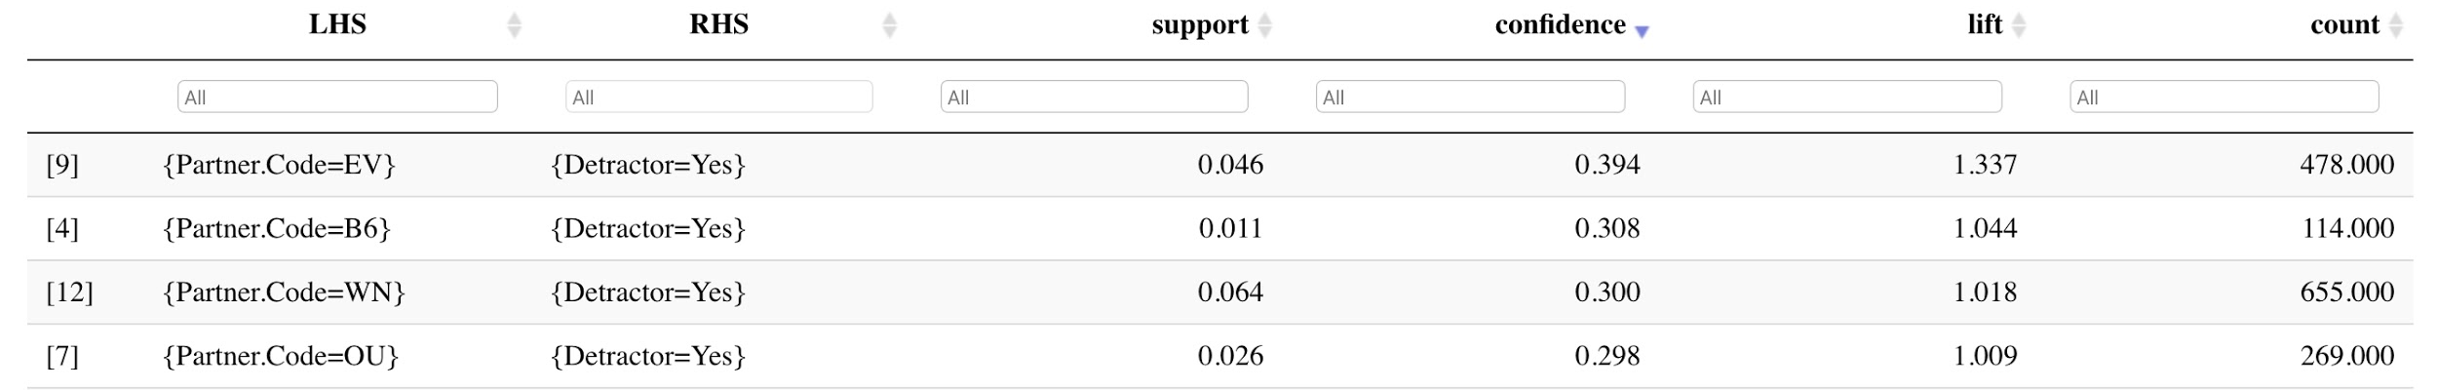
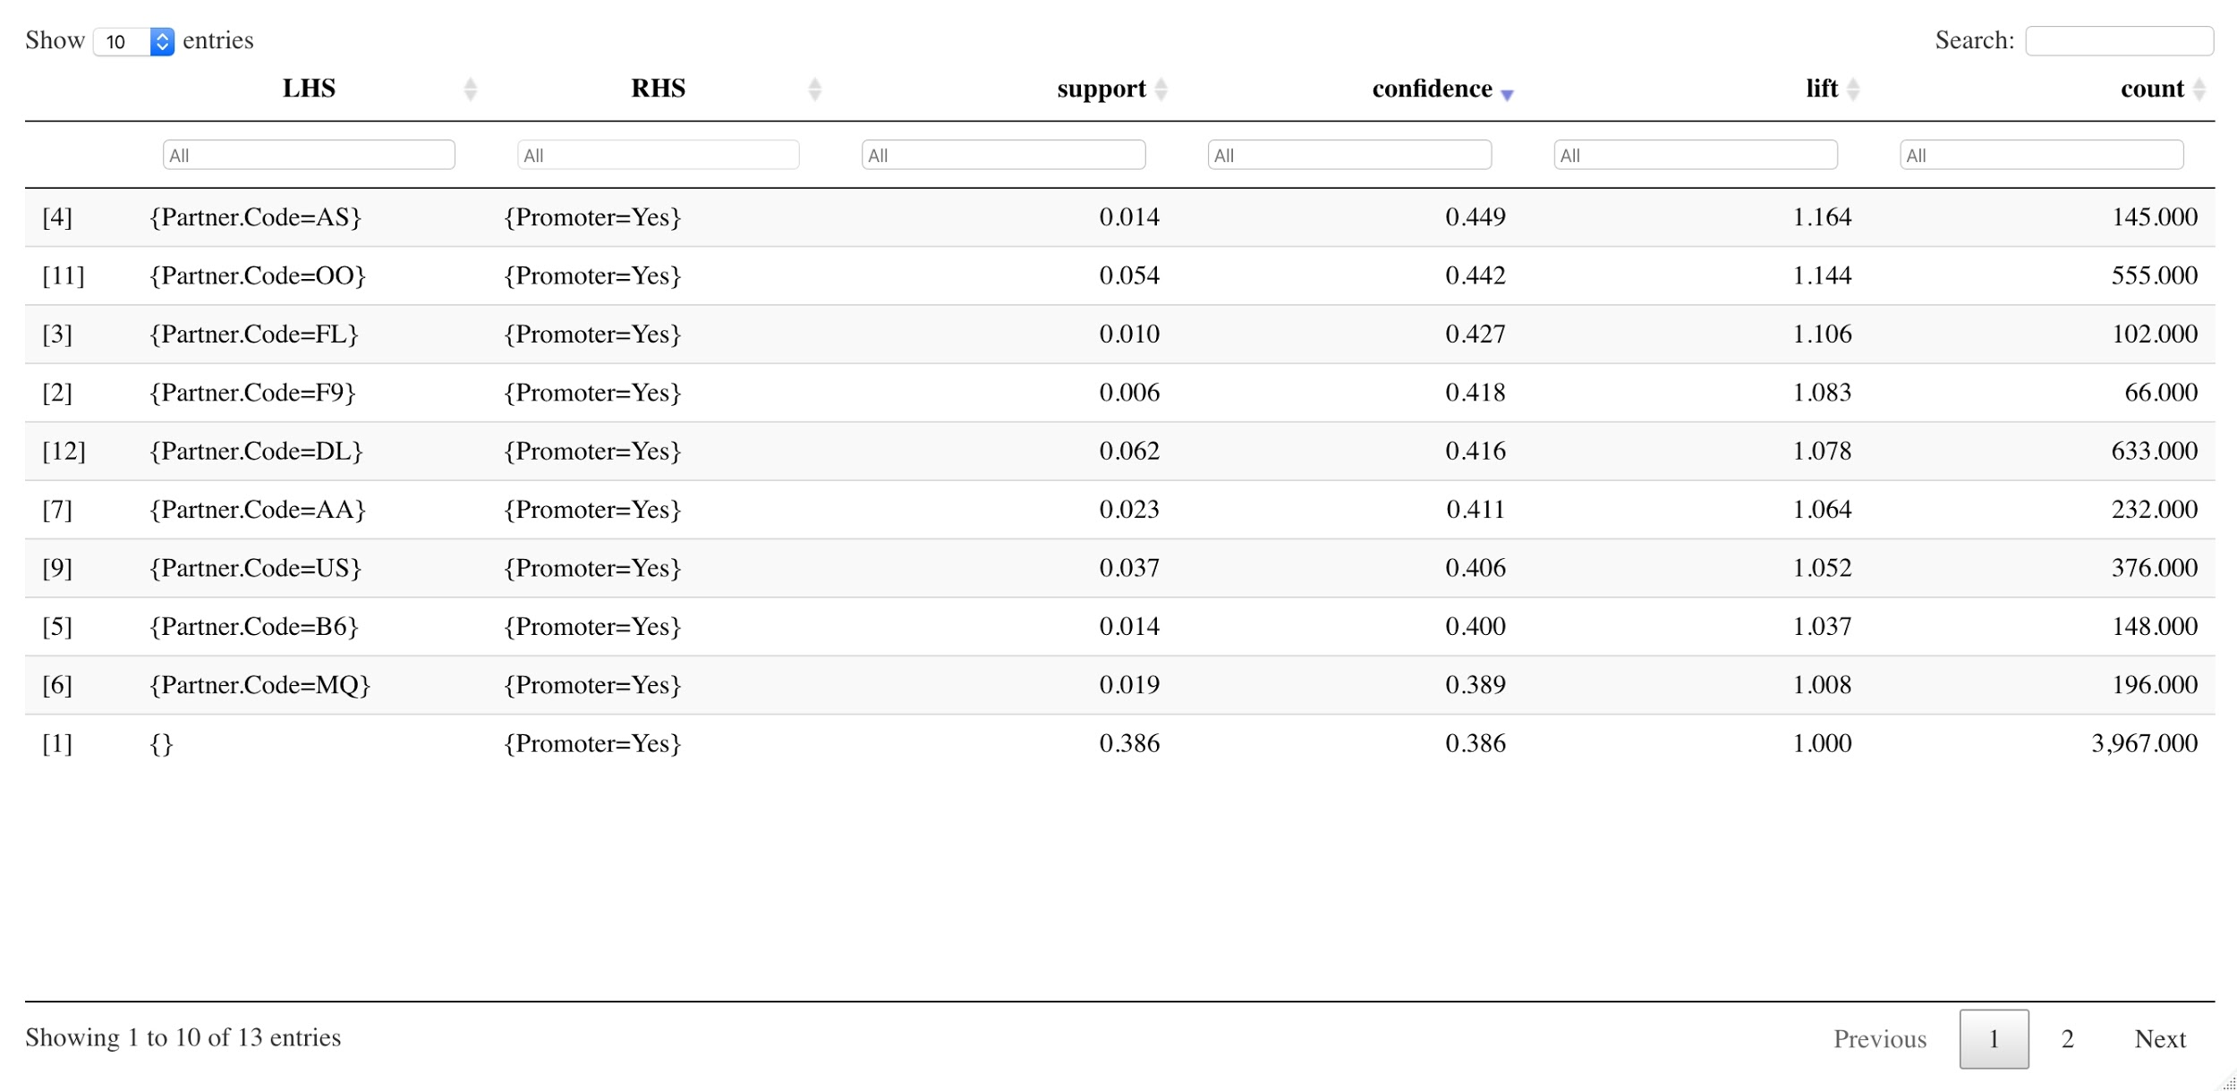
Associated rules mining/ NPS: 1. Partner airline:
Business recommendation: Terminate partnership with EV, increase partnership with AS, OO, FL, F9

Slide 10
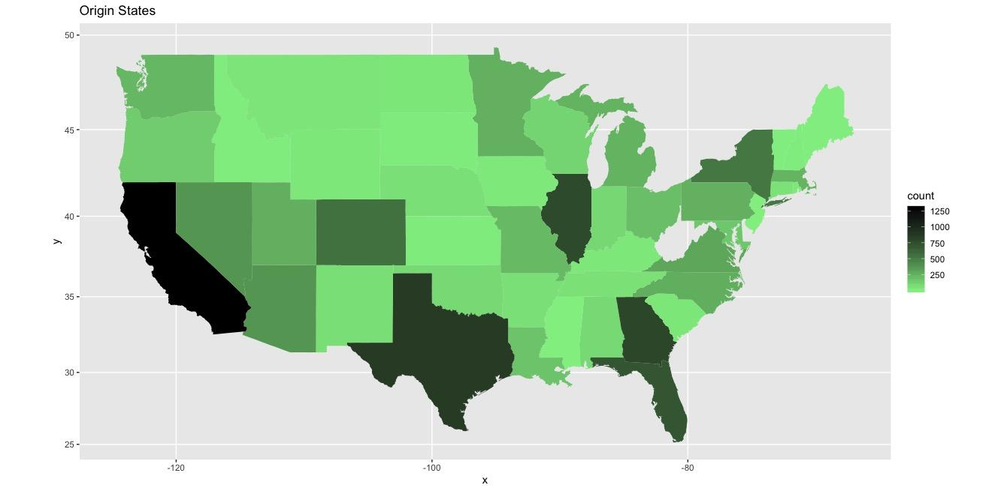
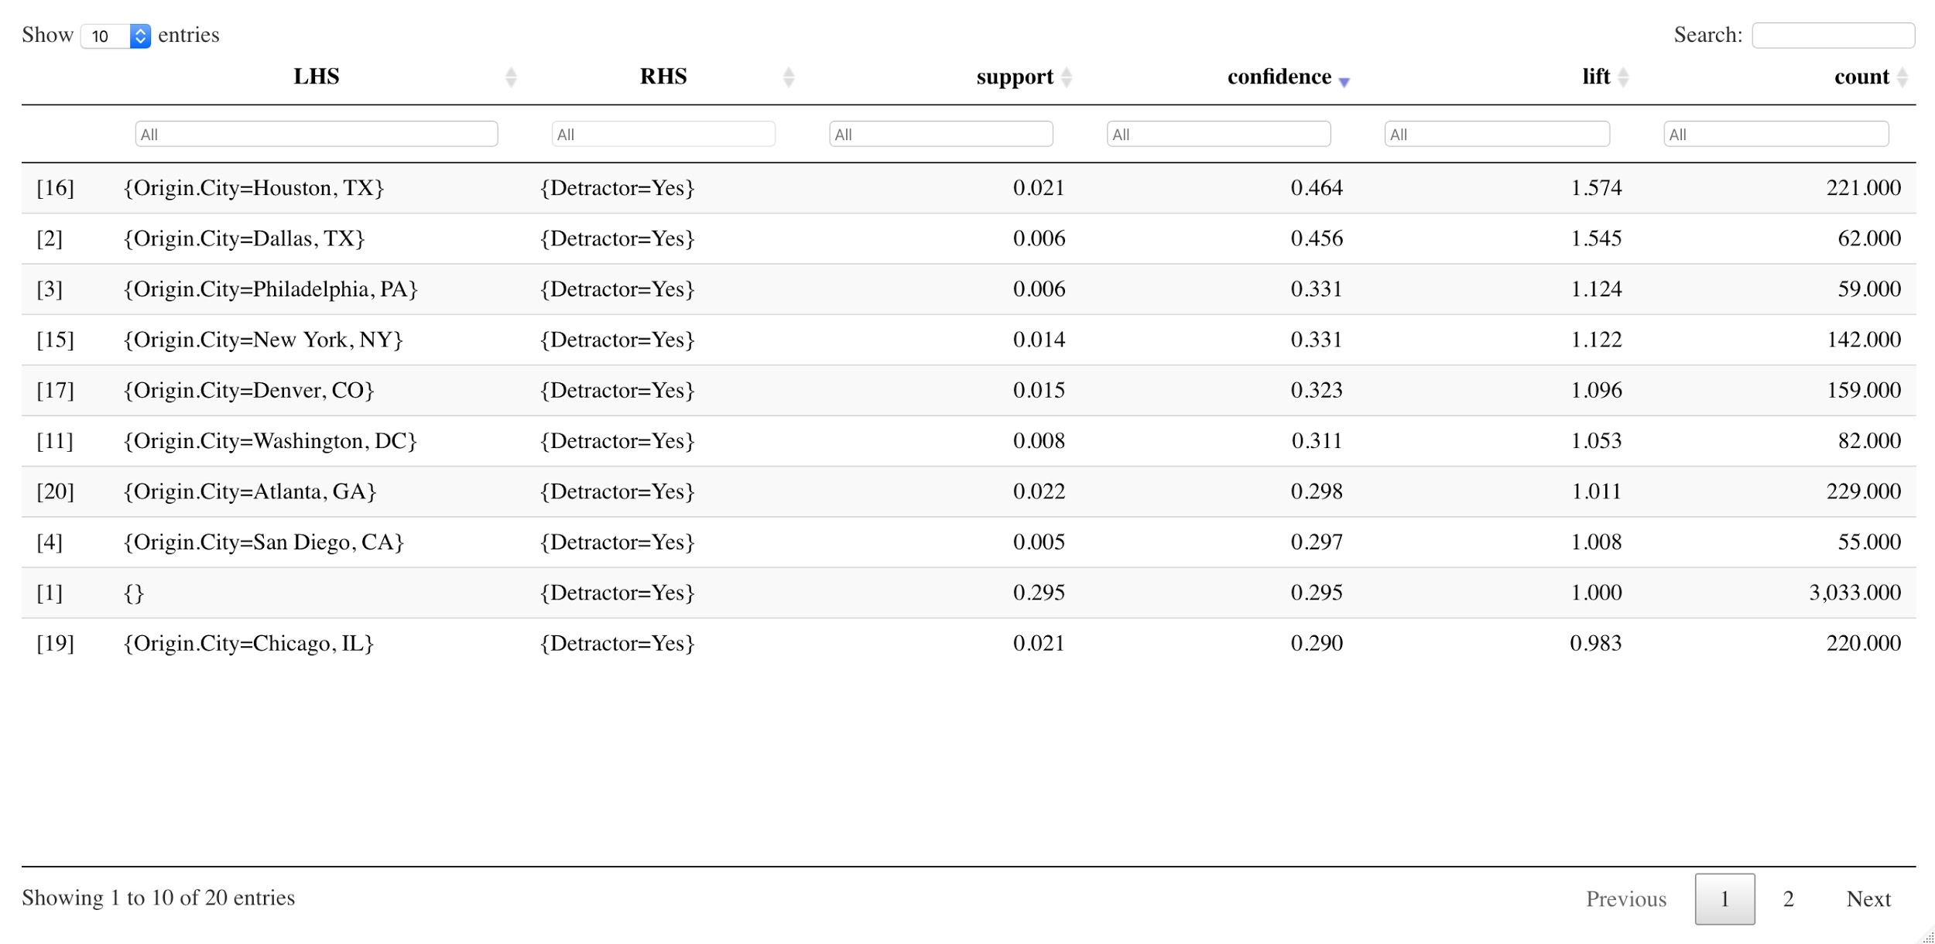
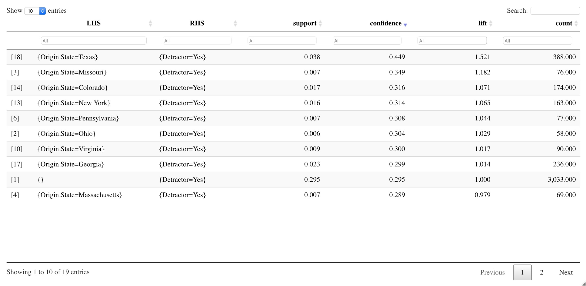
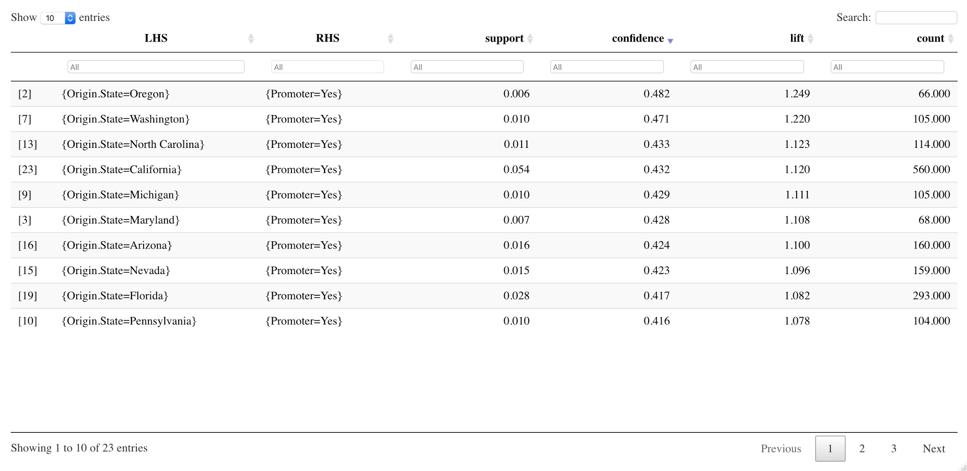
2. Origin State and City:
Business recommendation: Provide staff training to TX crew, improve facilities in the airport – use CA, OR, WA as reference points

Slide 11
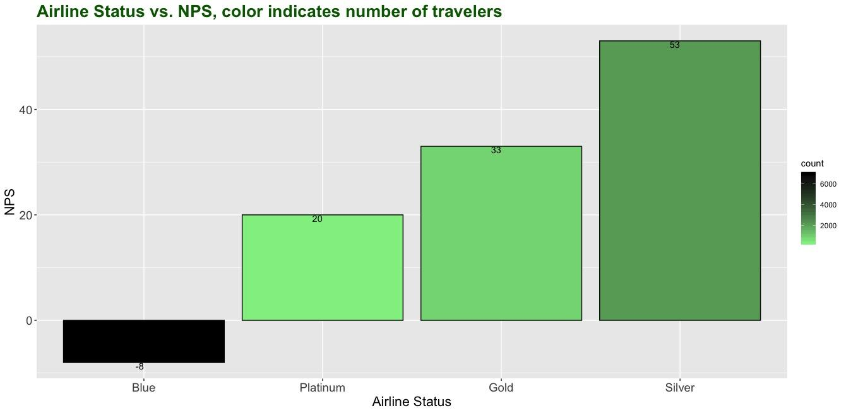
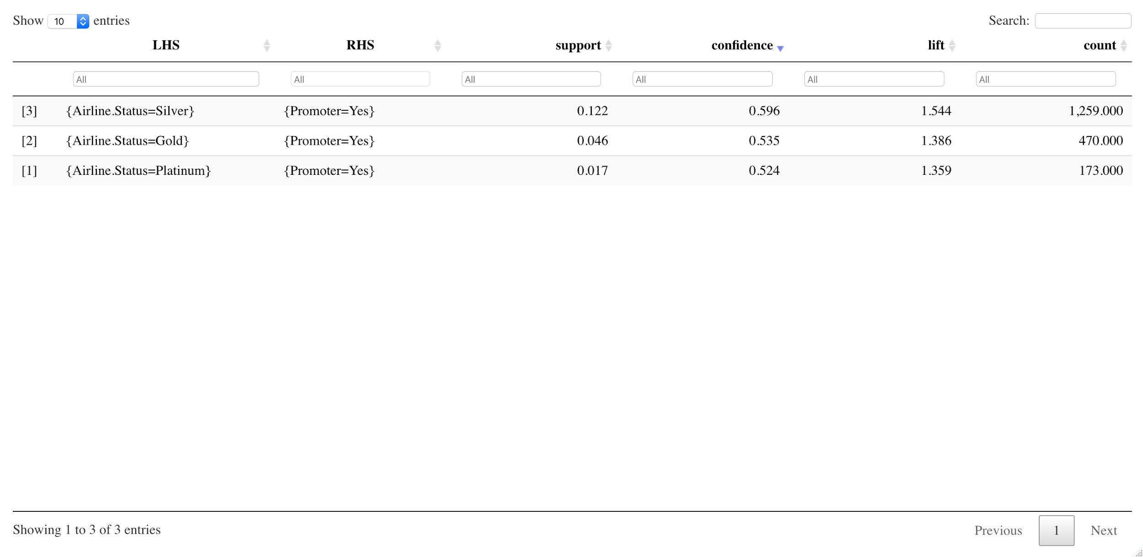
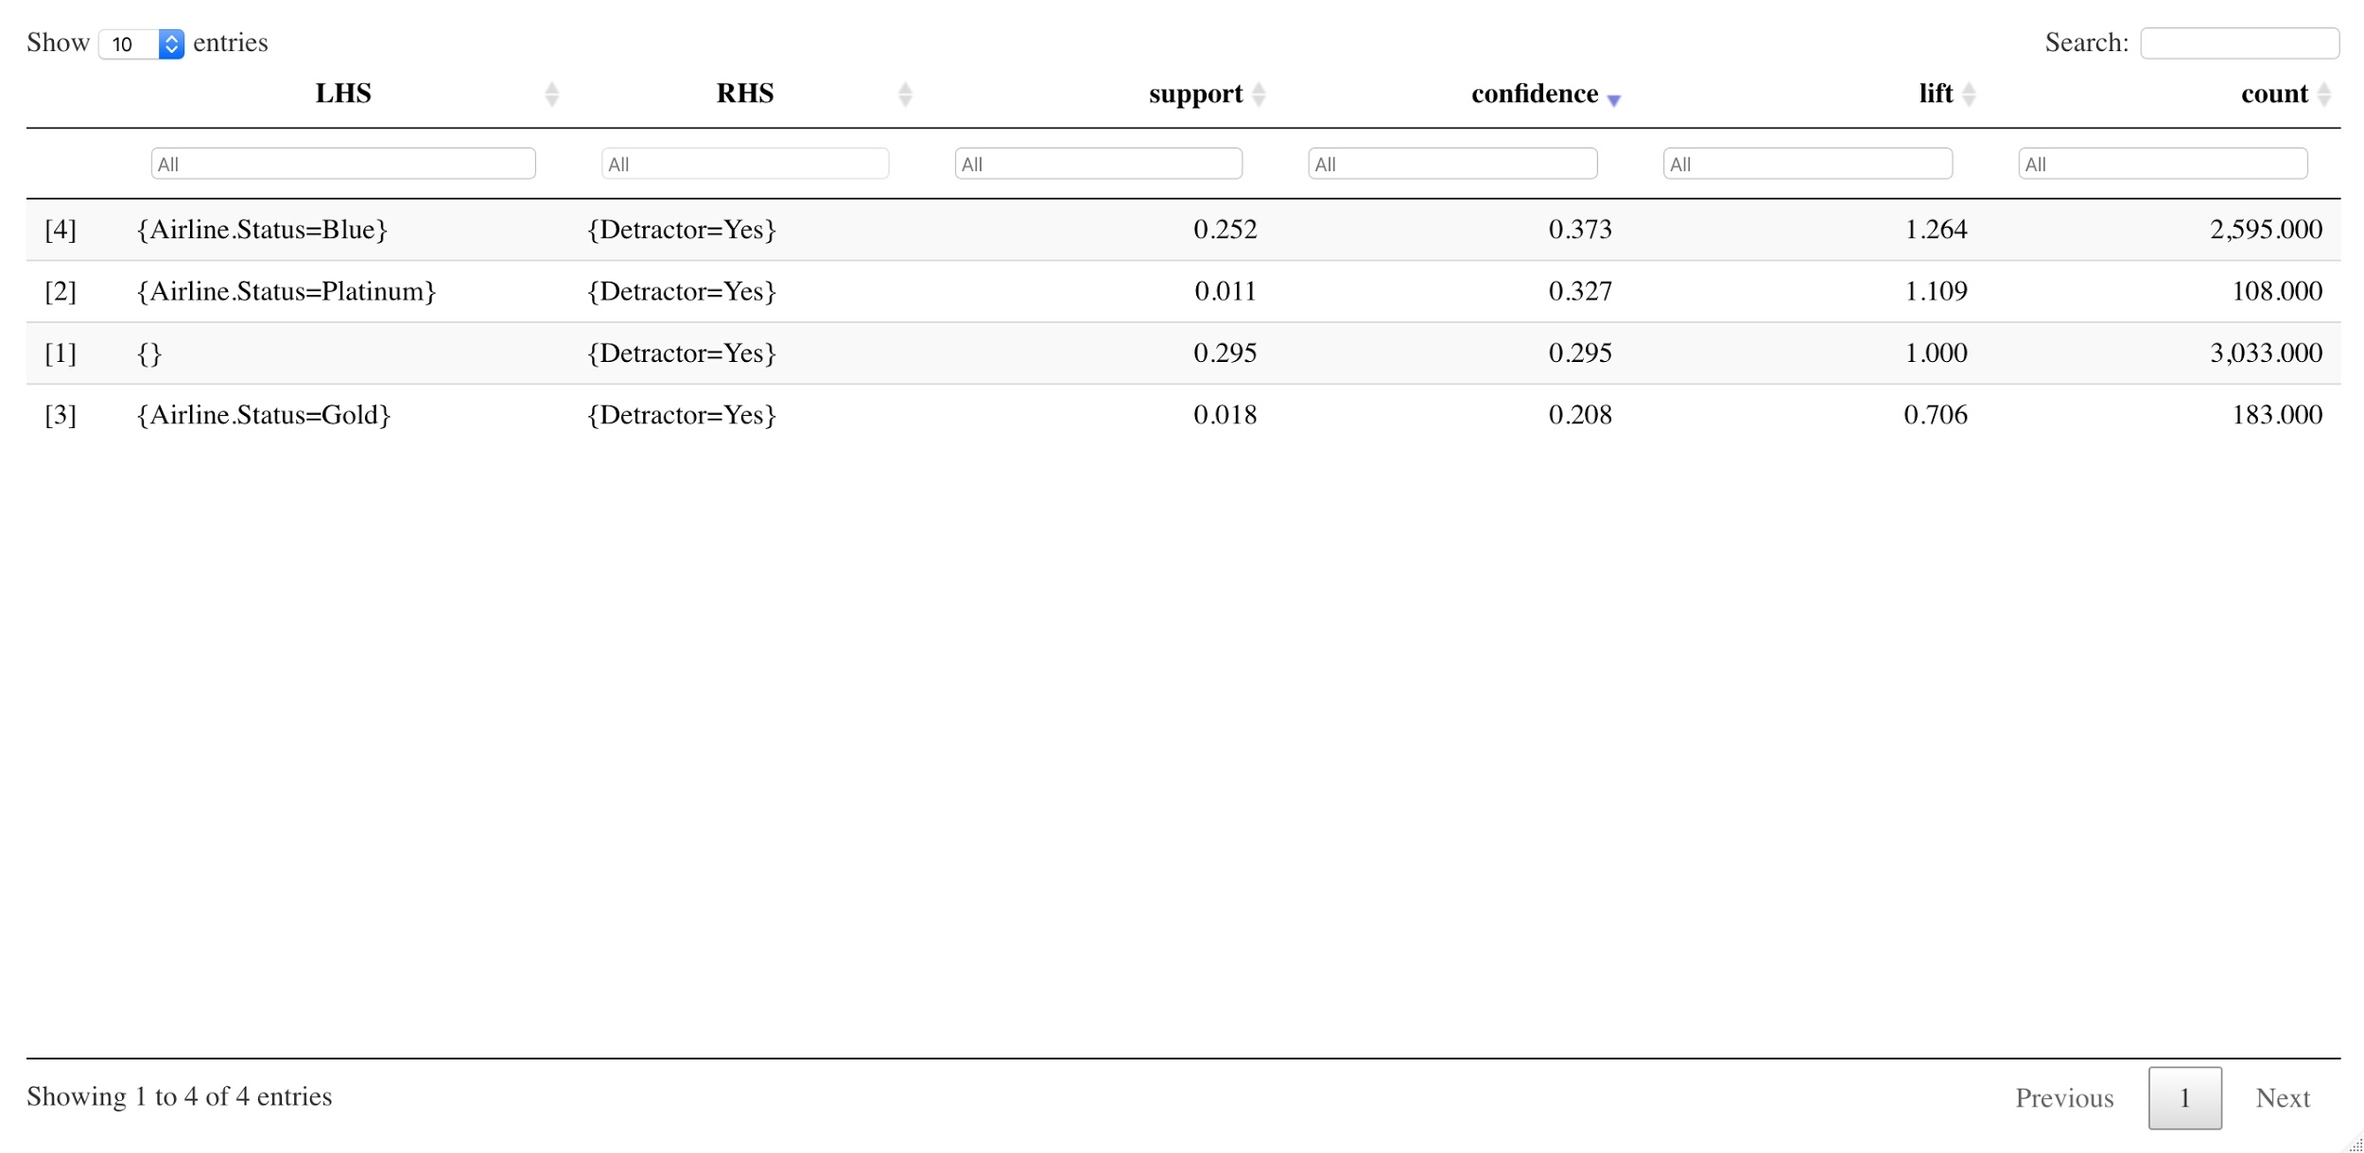
3. Airline status:
Business recommendation: Overhaul services offered under Blue status. Use services offered under Silver status as a reference.

Slide 12
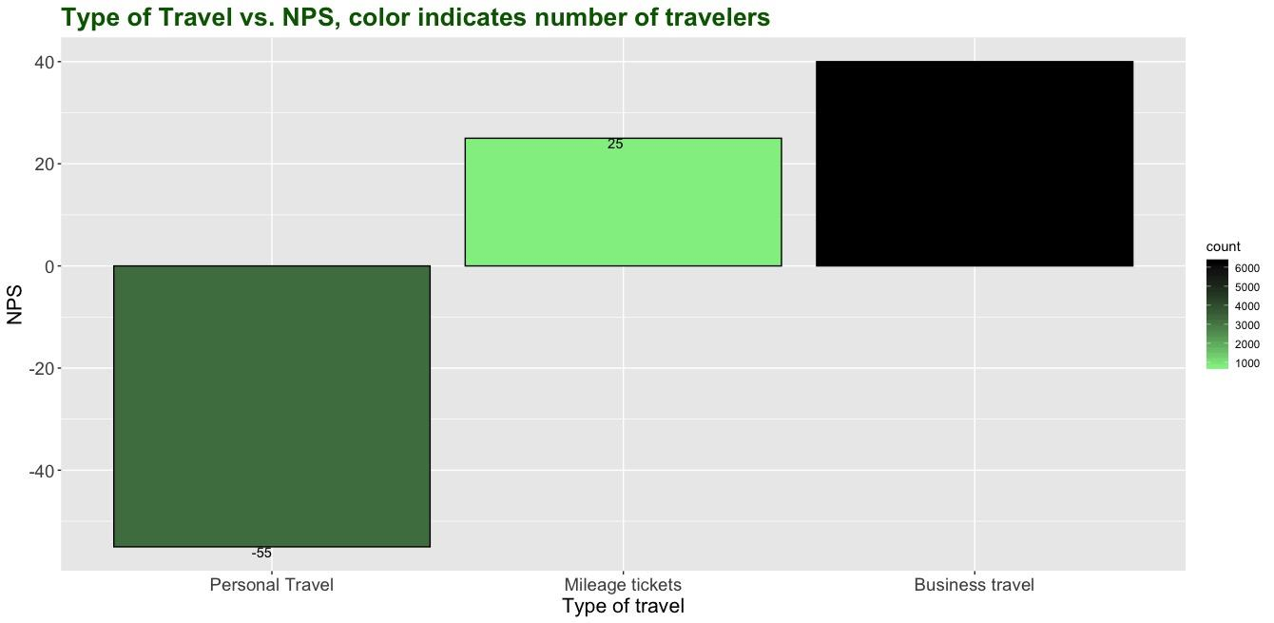
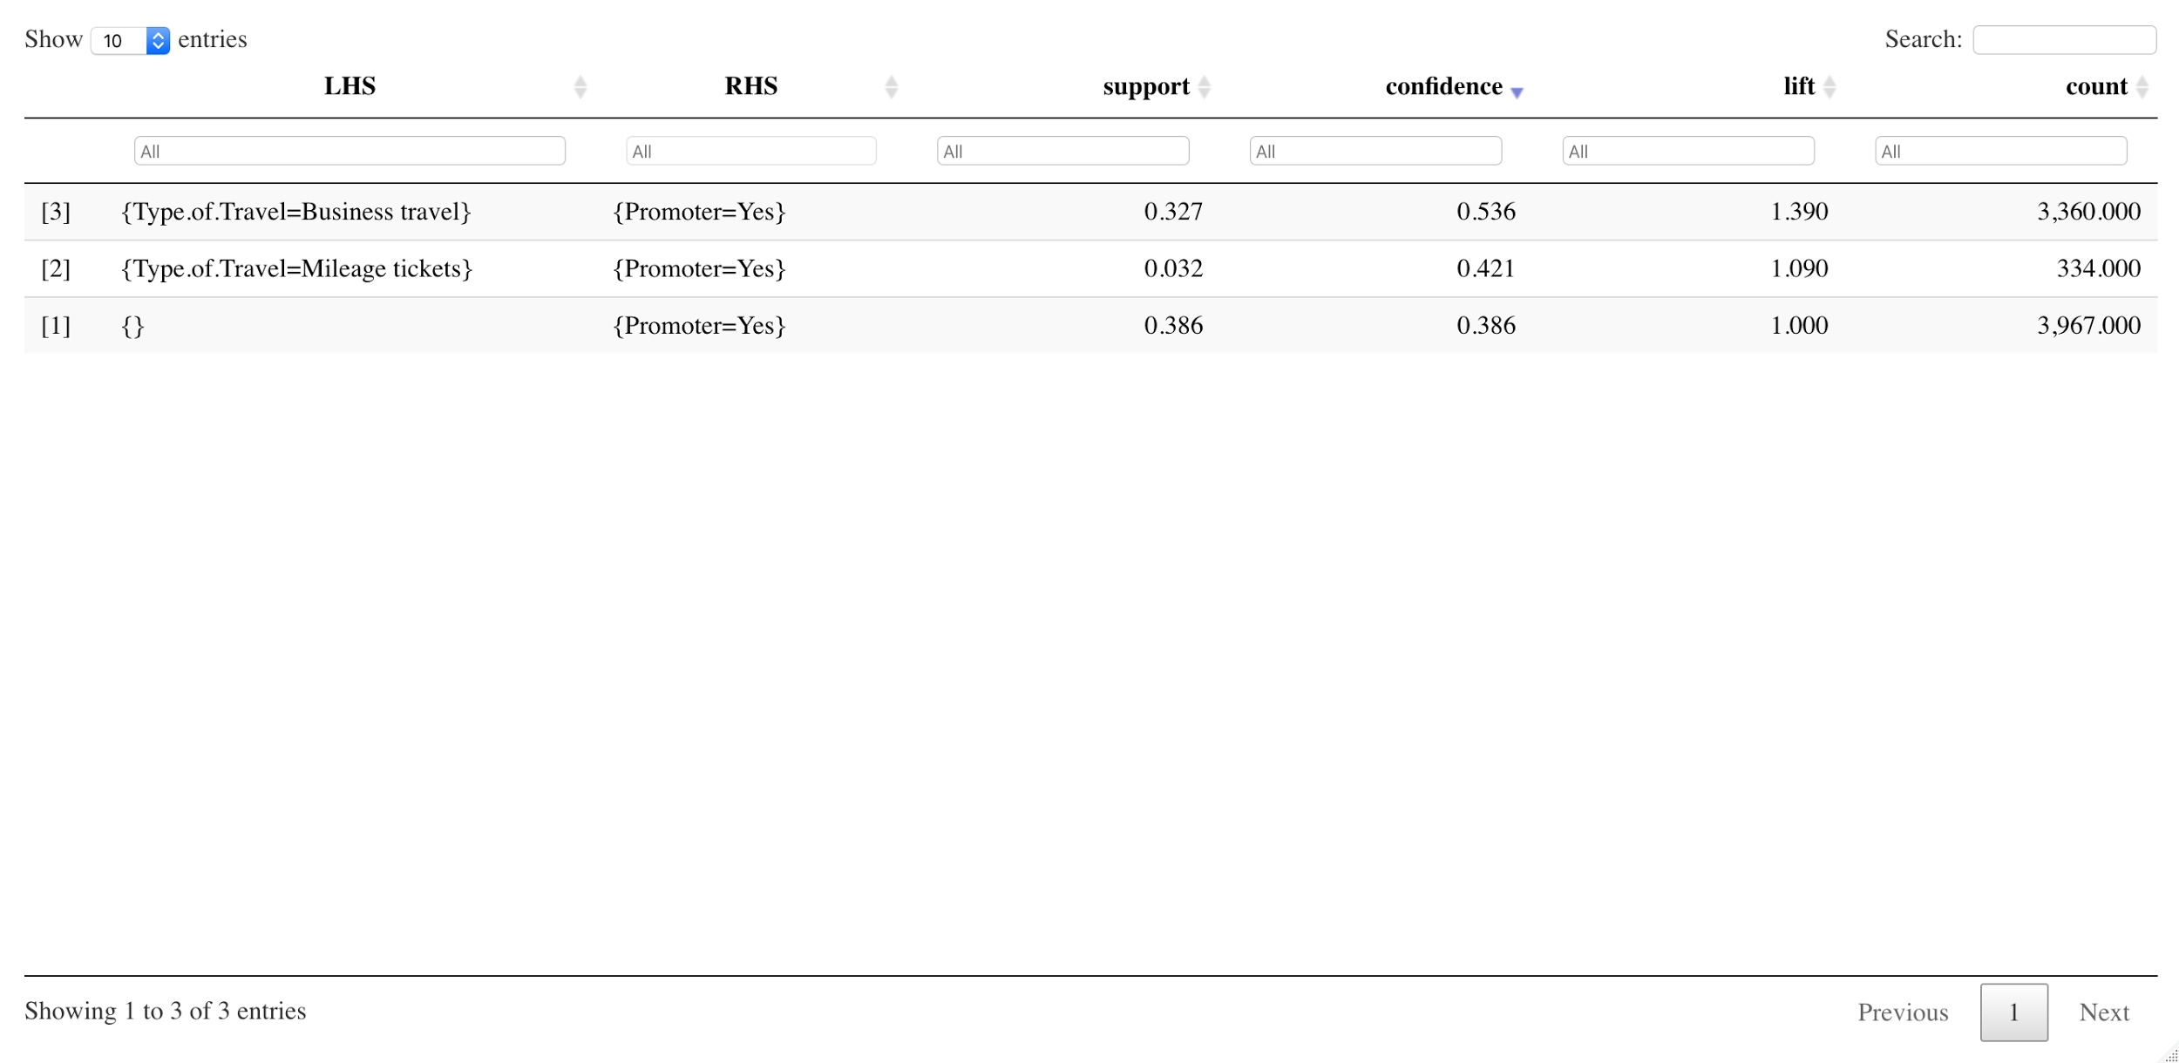
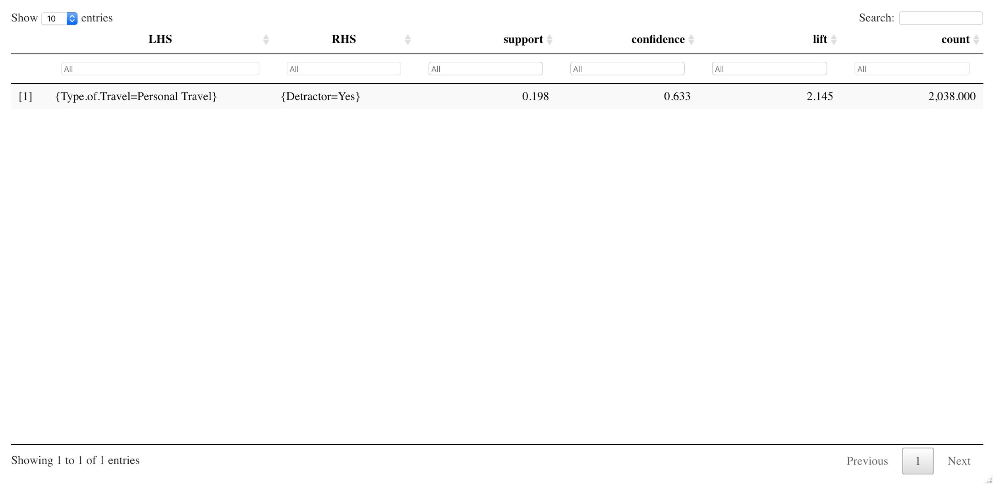
4. Type of travel:
Business recommendation: Market more to businesses, than personal travelers – form contracts to provide flight services to businesses at discounted rates

Slide 13
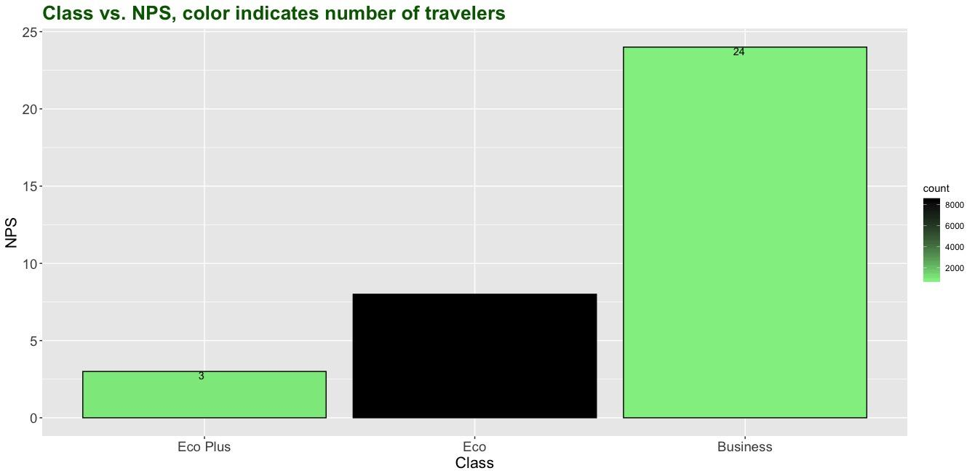
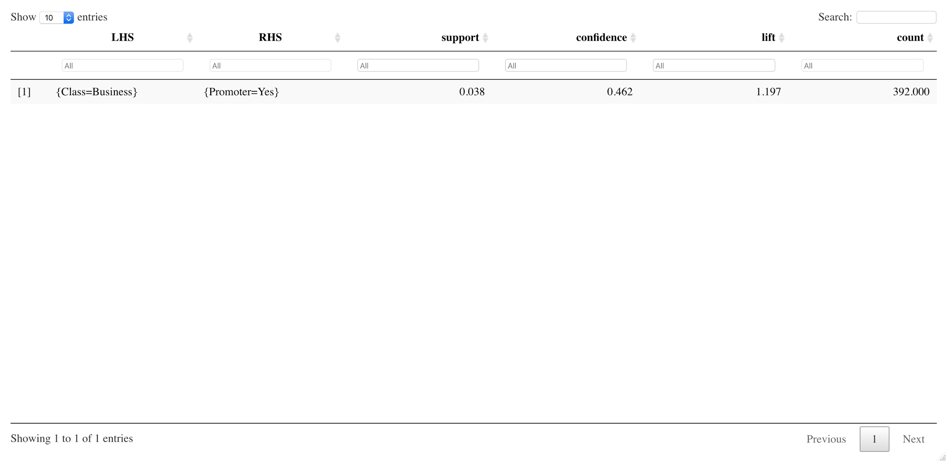
5. Travel class:
Business recommendation: Improve services offered in Eco Plus class.

Slide 14
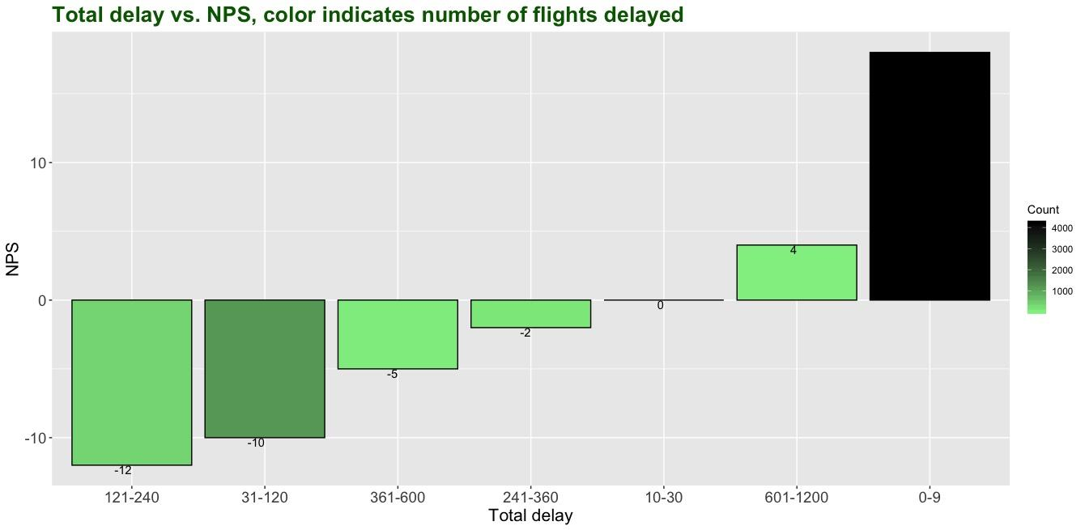
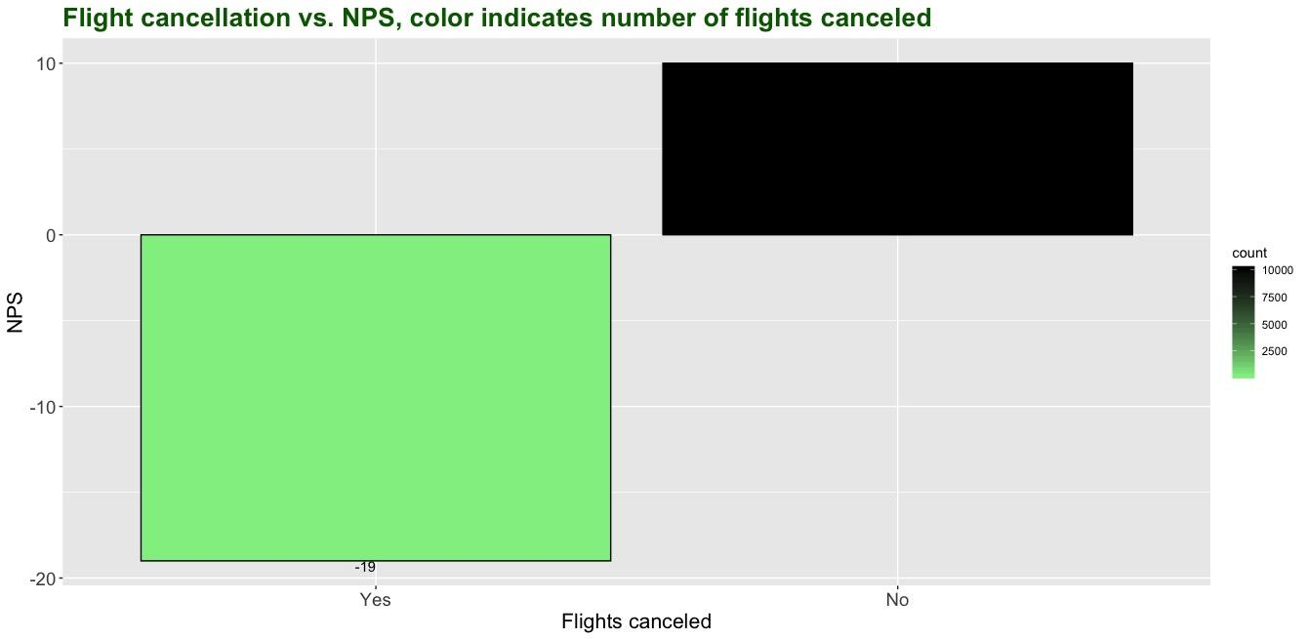
6. Total delay: Arrival delay + Departure delay 7. Flight cancellation
Business recommendation: Avoid delays longer than 10 minutes. Avoid flight cancellations.

Slide 15
Conclusion
Focus on keeping well-performing partner airlines, providing staff training and improving airport facilities in selected cities and target businesses, in order to reduce customer churn.

Slide 16
Thank You
Any questions?

